Slide 1
Firearms Trafficking to Central America
Inspecting the data for Guatemala
and
considerations for Congressional action
Susan Waltz
Professor emerita of Public Policy
University of Michigan
24 March 2022

Slide 2
GUATEMALA: Guns, Homicides, Human Rights
An abundance of firearms
Among the highest incidence of gun deaths worldwide
Clandestine security forces (CIACS), aka “the hidden power”
Human Rights, risk of “unlawful or arbitrary killings, including extrajudicial killings arranged by government officials” (DOS, 2021)

Slide 3
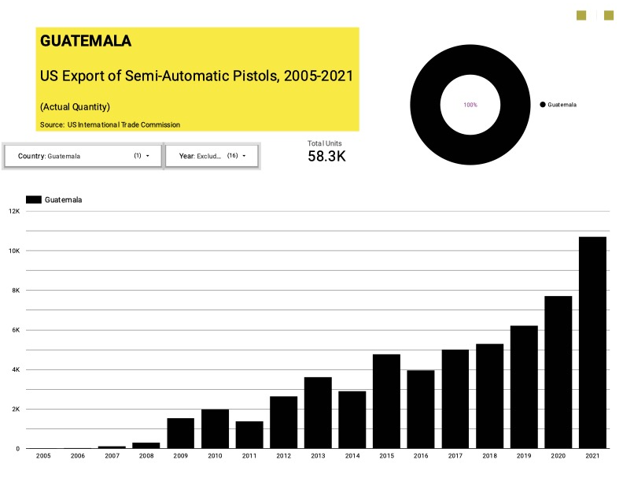
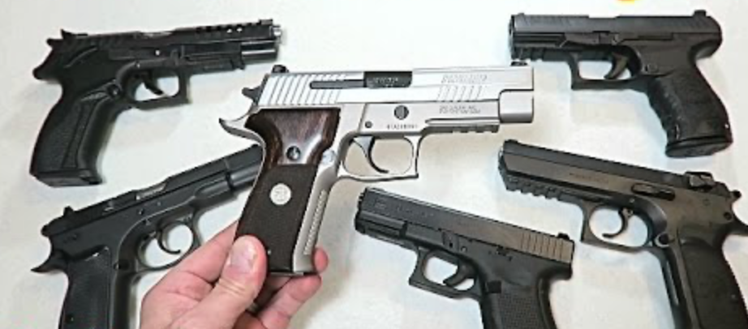
US
handgun exports to Guatemala

Slide 4
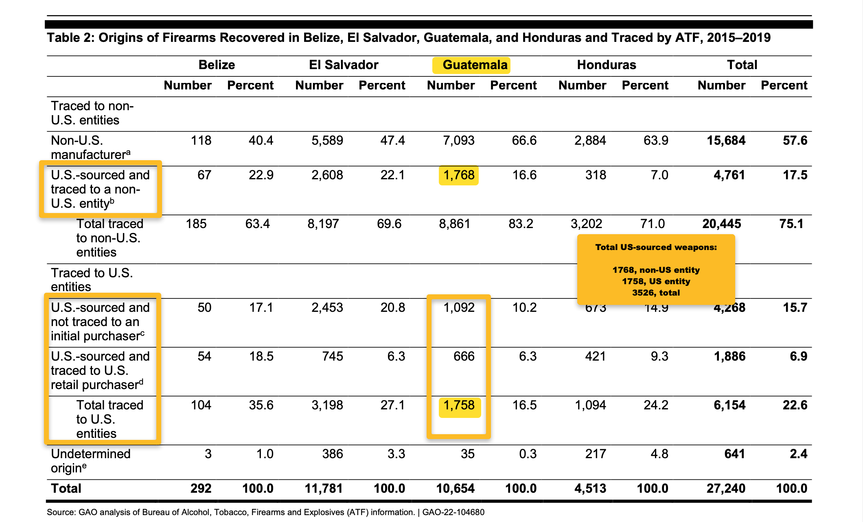
GAO: More than half of US-sourced firearms recovered in Guatemala originated in authorized exports

Slide 5
Think About It
How many firearms did the US export to Central America from 2015-2019? 72,086. (Source: USITC, compilation of 12 HTS items)
Of the 10,915 US-sourced firearms recovered from crime scenes in Central America 2015-2019, how many originated in legitimate exports from the US? 4,761 (Source: GAO, Trafficking, 2022)

Slide 6
Concerns Arising from GAO report
Licensed sales approved by Department of Commerce have skyrocketed since March 2020
Severe decline in end-use checks since Covid-19
“Disrupting firearms trafficking is not an explicit US objective in Central America” (GAO, January 2022)

Slide 7
US Firearms Licensed for Export, 2020-2021 (GAO, Firearms Trafficking, 2022, p. 30)
From 2010-2019, US exports of semi-automatic pistols to Guatemala
averaged 3790 annually.
In 2021, 10,706 such handguns were ultimately exported to Guatemala.

Slide 8
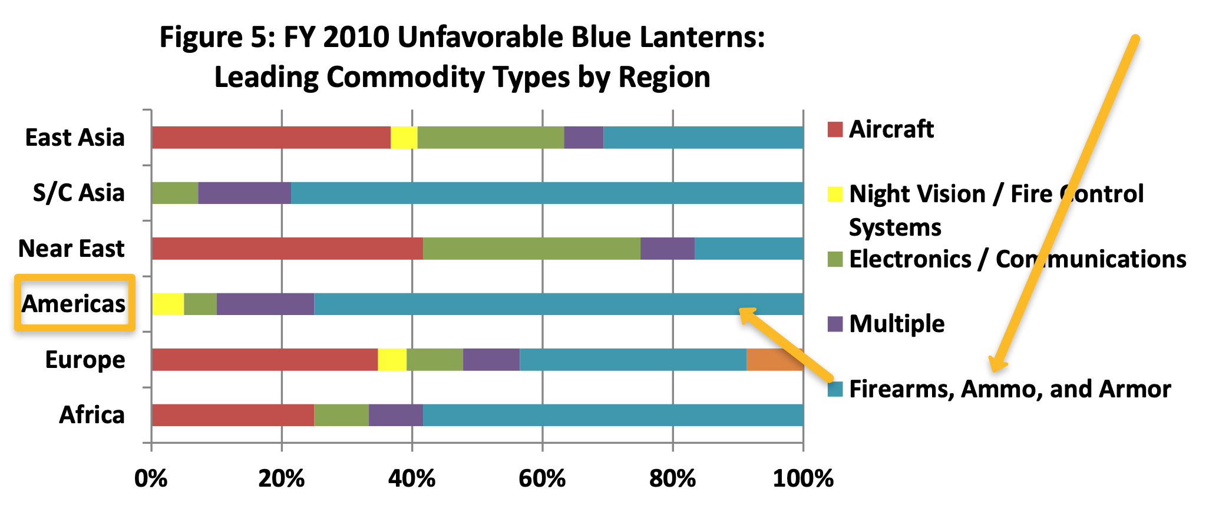
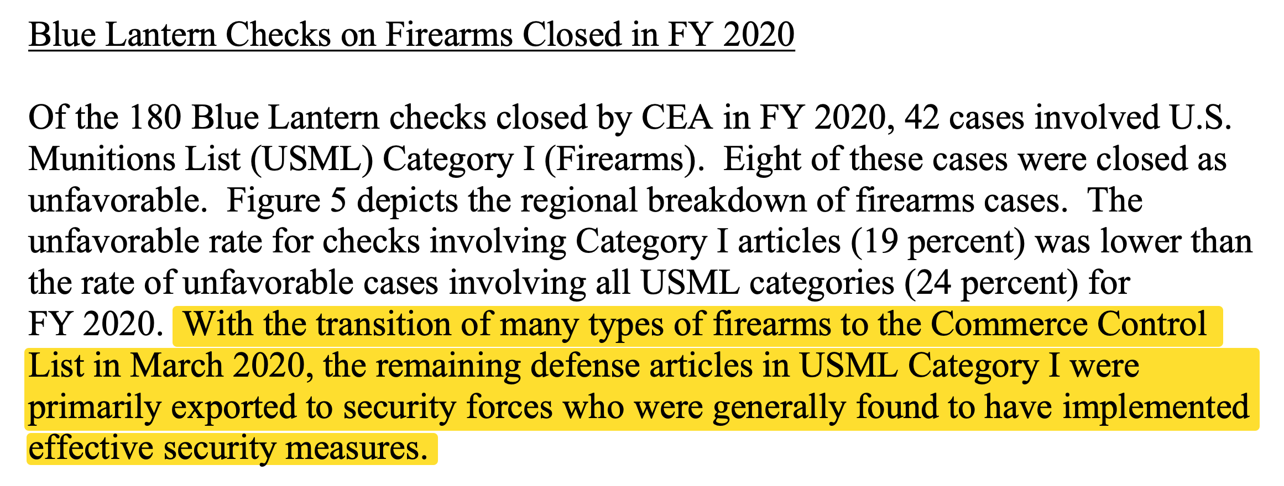
Whither Blue Lantern?

Slide 9
“Disrupting firearms trafficking is not an explicit US objective in Central America”
US Strategy for Engagement in Central America

Slide 10
Ameliorative measures?
Dial back on authorized transfers
Regulatory measures (impose new “reasons for control,” alter ”presumption of approval” posture]
Apply human rights conditionality – cap exports, or attach end use conditions
Consider revoking some licensed transactions
Recognize limitations of OAS Firearms Convention
Activate end use monitoring
Ask BIS to provide detailed explanation of firearms end-use controls and post-shipment expectations
Station personnel in Central America (ATF, BIS)
Destroy surplus police firearms (potential funding via DoS Weapons Removal & Abatement)
Elevate concern for arms trafficking and diversion on the policy agenda
White House: Incorporate gun violence and proliferation into “Root Causes” analysis
Congress: enhance monitoring of Congressional sales notifications – possibly link to disposal of surplus weapons or end use monitoring

Slide 12
Police Cooperate with Gangs – El Salvador
Elmer Rogel Lopez was kidnapped by police in El Salvador who believed he had reported a gang crime to other officers. The kidnappers beat him severely, put a gun inside his mouth, fired shots near his head, talked about killing him, and then turned him over to gang members, who beat him for another three hours. “The severe beatings and threats of imminent death that Rogel Lopez suffered over a two-day period show that he suffered past torture” by agents of the Salvadoran government, said the Ninth U.S. Circuit Court of Appeals in San Francisco in a 2-1 decision Thursday.
Egelko, Bob. “Beatings in El Salvador by police and gang members indeed torture, court says in granting asylum,” June 4, 2021 in The San Francisco Chronicle.

